Slide 1


2.6
Name Binding

Slide 2

Objectives
To understand the form and function of imperative statements including naming.
To understand the importance of Name selection (proper naming).
To understand the concepts of computational state, events, and actions.

Slide 3


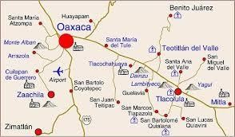

How can I call a student of this class?
…Student Name
How can I mention where I live?
…City/Place Name
How can I locate a book in library?
... Book name/ author name

Slide 4

How to locate resources inWWW?
The web contains trillions upon trillions of pages of information, every piece of this information has a unique name.
These names are informally known as web addresses but are formally known as Uniform Resource Locators (URLs).
The URL of a web page is technically not the name of the item itself, but is rather a way of locating the item.
Nonetheless, in a practical sense, the URL serves as both the name and the location of an item.

Slide 5
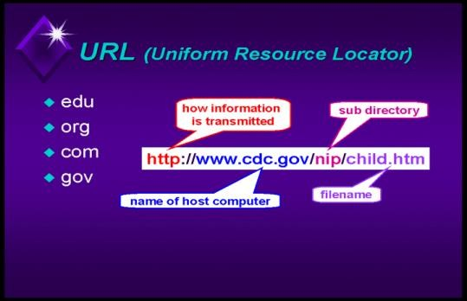
Did you know?
URLs are unique since a single URL.
Will not refer to more than one website.
For example, http://www.wikipedia.org/ always refers to the Wikipedia website and not to some weather or news page.
Most websites do not have two different URLs to refer to the same page on the site.
Most URLs contain a description of the information on the web page.

Slide 6
Did you know? contd---
For example, the URL http://en.wikipedia.org/wiki/Coral_snake.
Every URL indicates not only the content of the page but is primarily related to where the page can be located.
  Every computer on the Internet has a name and the first part of a URL identifies one computer on the Internet.
  Each computer also has a file system and the remaining parts of a URL correspond to the location of a file in that file system.

Slide 7
User Input
We want to ask the user a question.
  print("Choose from the following options:")
    print("1: go left")
    print("2: go right")
    The user gives an answer, But where do we put it???????

Slide 8

Variables
A variable is like a box we can put information in.

Slide 9
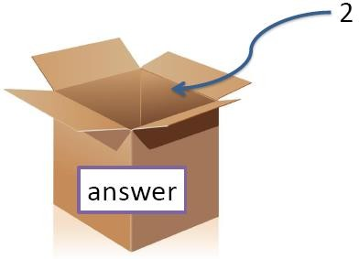
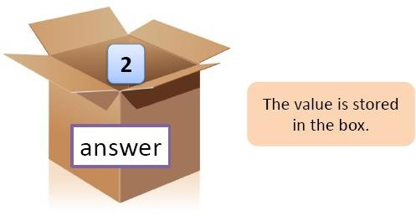
Variable
User Types 2

Slide 10
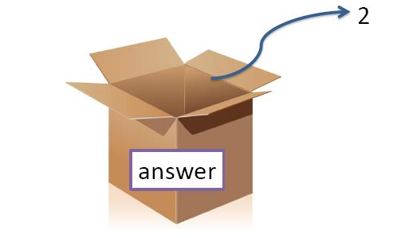
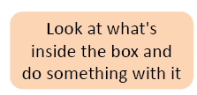
if answer == 2:
print("You chose to go left, ")
print(" a most dangerous path.")

Slide 11
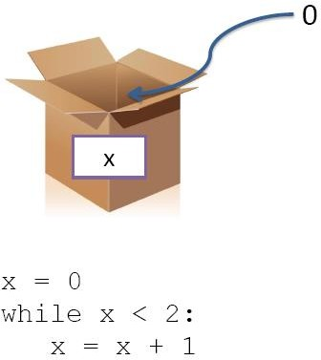

Slide 12
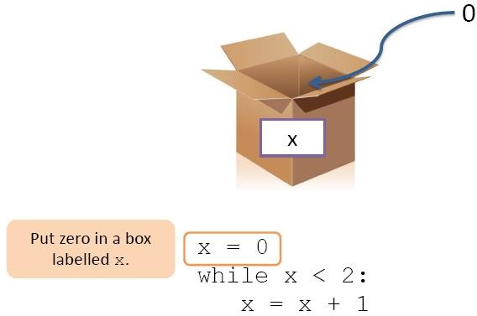

Slide 13
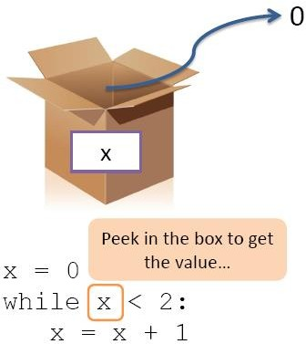

Slide 14
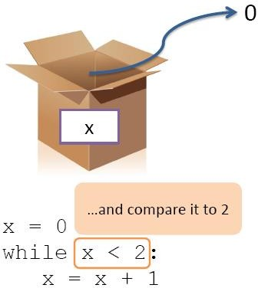

Slide 15
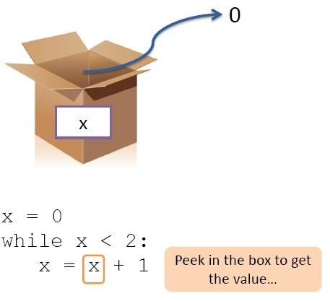

Slide 16
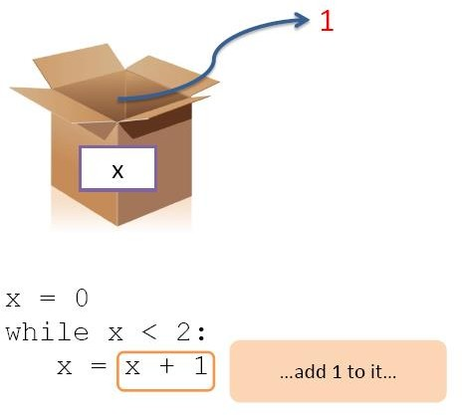

Slide 17
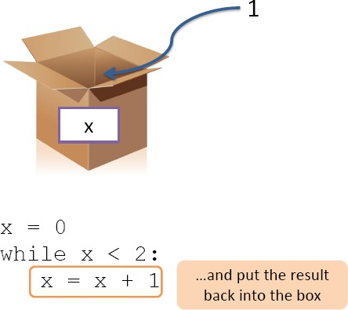

Slide 18
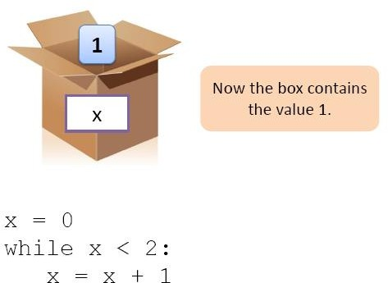

Slide 19
Names
An identifier (or name) is used to identify the entities, eg., variables,
module names.
Naming conventions increase readability. Good naming practices
  Never use I (lowercase L ) or O (uppercase O ) as variable or constant names.(Confused for 1 or a 0)
  What about the length of the name? “total_number_of_entries_with_mangled_or_out_of_range_dates ”?
    This is an extremely descriptive name.
    First, they are difficult to type.
    Second, remembering the exact wording of such a long name is not easy.
    What happens when you try to use this variable in a statement?

Slide 20
Names contd--
Connection character (e.g. first_name, First-name)
  What about first$name???
Case sensitivity (e.g.Name,name,NAME)
Don´t use negative logic for your variable names.
  Good Example: IsEnabled.
  Bad Example: IsNotEnabled.
It’s always easier to read and understand a statement that is expressed in a positive language than that in a negative language.
Reserved words or keywords?
  (PI, Cu(copper))
  What about assigning PI( )=24(hours of a day), Cu in chemistry to represent metal gold?
    Spend a few minutes thinking about your
variable names.

Slide 21
Guidelines for Naming
Names should be unique.
One item should not have more than one name.
Eg. “get the data”,using multiple words like “load”, “fetch”, “get” may be confusing.
A name should be descriptive. Eg. FileAgeInDays is better than “faid”.
  Descriptive names reduce confusion.
  They help us understand the role of the item.
  They help us to understand the content of the item.

Slide 22

Try it yourself
Assume that a user need to create an e-mail account. List the fields required to be filled in registration form and suggest suitable names, datatype (number, string, boolean) and range of values
for the attributes (fields) identified.

Slide 23
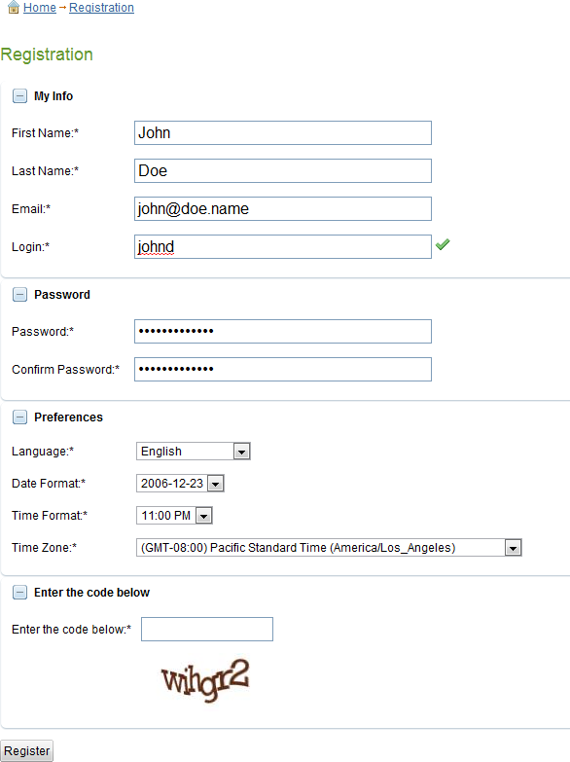

Slide 24
Proper name selection
Computer scientists have long recognized the critical importance of choosing correct names for the elements of a program.
Computer scientists also recognize that a set of well-named programming elements shows a mastery of the logic and nature of the underlying computation.
An element is well named if the name descriptively and correctly reflects the central essence of the element.
Proper naming thus enables a computer scientist to more clearly reason about the algorithm and data of the program.
Poorly named program elements reflect a confused understanding of the elements and also make clear-headed reasoning more difficult.

Slide 25
Proper name selection contd---
Appropriate choices of names are keystone for good style.
Poor naming makes is difficult to understand (leads to confusion).
In the Figure: Importance of naming, Algorithm2 uses appropriate names.
Algorithm 2
Algorithm 1
Get hours, minutes, seconds
If hours<24 and minutes<60
and seconds<60
Return true
Else
Get a,b,c
If a<24 and b<60 and c<60 Return true
Else
Return false
Return false
Figure: Importance of naming

Slide 26
Proper name selection contd---
Two algorithms for computing cost of gas filling is given in Algorithm 1 (Version 1)and Algorithm 2 (Version 2).
Can you comment on the names in terms of their readability?
Which algorithm follows proper naming conventions?
Algorithm 1
Cents
Size
Money
Algorithm 2
DollarsPerGallon
TankCapacity
DollarsToFill
3.75
3.75
10
Size * Cents
10
TankCapacity * DollarsPerGallon
Figure: Version #1
Figure: Version #2

Slide 27

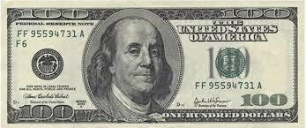
Proper name selection contd---
An algorithm using an exchange rate of 10 to determine the BRL that corresponds with US$3.75 is given in Figure: Concurrency conversion.
1. USD 3.75
  ExchangeRate 10
  BRL USD X ExchangeRate
Figure: Currency conversion
What will happen in the above examples if descriptive names are replaced with names like x,y,z etc.

Slide 28
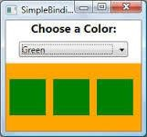
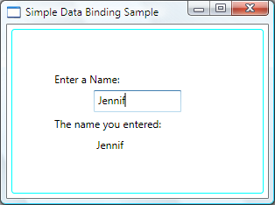
The concept of binding
A binding is an association, such as between an attribute and an entity, or
between an operation and a symbol.
Name binding is the association of a name, also known as an identifier, with a value.
Identifier Expression
Once an identifier is bound to a value, the identifier is said to reference the corresponding value such that when the identifier is used in some later context, the identifier stands for the value to which it is bound.

Slide 29
Computational state
The computational state of a program is the collection of name bindings that are active at any single point in time.
Since any programming action will potentially change the state of a program, we can describe the meaning of a program by examining the sequence of changes made to the state as the program executes.
Eg. 1
  X ← 3 The state is now {X = 3}
  Y ← X + 4 The state is now {X = 3 andY = 7}
  Y ← X +Y The state is now {X = 3 andY = 10}
  X ← X *Y The state is now {X = 30 andY = 10}

Slide 30

Computational state contd---
Consider the following sequence of name bindings.
1. X ← 3
2.Y ← 4
3. Z ← 3 + 4
The first two actions associate the name X with the value 3 and the nameY
with the value 4.
The effect of the binding on line 3 associates the name Z with the value 7.
  Can you represent the following bindings?
    Trevor gets Alf’s value
Alf gets Bridgit’s value
Bridgit gets Trevor’s value

Slide 31
Answer
Trevor←Alf Alf←Bridgit Bridgit← Trevor

Slide 32

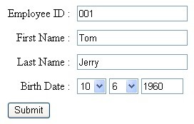
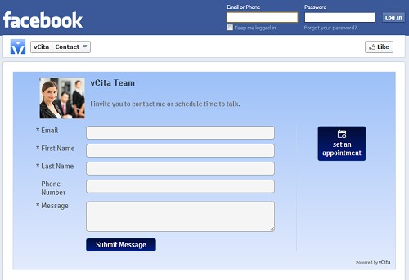
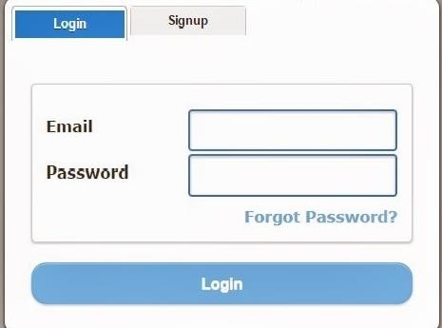
Identify the datatype of the binding(number, string) and suggest a possible value that can be bound

Slide 33

Answer
Employee Id – Number, First Name & Last Name : String, Birth Date (Day, Month,Year- number in valid range (1- 31,1-12…, SUBMIT (Boolean-
Clicked= True/False)
E-mail (String): joe@example.com
As you can see, the address has four components, joe
@ example com
'Joe' corresponds to the 'local' segment of the address, and is the recipients username at a mail service. It connects the user to the machine.
The '@' sign is also the one character of any email address which remains the same. Ray Tomlinson was responsible for proposing the use of the '@' sign in 1971.
Part 3 and 4 of an e-mail address are the hostname,
'example.com'.
Phone Number
Landline
aaa
areacode
nnn nnnn
local subscriber number
Mobile
9x | aaa | nnnnn
Access | mobile | local
code | switch | subscriber
 | code | number

Slide 34
Answer contd…
E-mail : As discussed in previous slide
Password: (String – Make your password strong by including text, number and spl charaters Login, Signup (Boolean- Clicked= True/False)

Slide 35
Given that width = 17, height = 2.0, and delimiter =‘ . ’
For each of the following expressions, find the value of the expression and type (of the value of the expression) (number, string,boolean)
  width/2
  width/2.0
  height/3 4. 1 + 2 * 5
5. delimiter * 5

Slide 36
Answer….
Given that width = 17, height = 2.0, and delimiter = '.'
For each of the following expressions, can you find the value of the expression
type (of the value of the expression) width/2 = 17/2 ------------- 8(Integer)
width/2.0 =17.0/2.0 ----------8.5 (Float)
height/3 =2.0/3 -----------0.66 (Float) 1 + 2 * 5 ---------11
delimiter * 5 -------ASCII value of ‘.’ (46)* 5 = 230

Slide 37

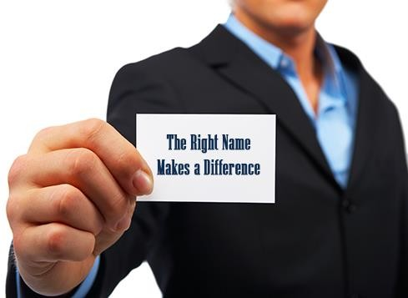
What has been described?
Names and name binding concepts.
Importance of proper naming conventions.
Credits
Programming Languages,2nd edition,Tucker and Noonan
www.cse.msu.edu/ Organization of Programming Languages-Cheng (Fall 2004)
Google images

